Slide 1
Feature Visualisation of CNN
Qing Pan
Supervised by: Dr. Jize Yan & Dr. Hansuang Kim

Slide 2
Overview
01. Introduction
02. Methodology
03. Results and Conclusions

Slide 3
Introduction

Slide 4

Motivations
Convolutional neural networks (CNNs) have been widely used in Computer Vision field.
CNNs become more and more opaque.
A growing sense that networks need to be interpretable for humans.
Feature visualisation is one of the most powerful tools to understand the black-box neural networks.

Slide 5
Objectives
Implemented feature visualisation via Activation Maximization (AM) channel-wise to reflect what a certain channel is doing.
Applied several regularisation methods on AM.
L2
Total variance
Transformation robustness (jitter, scale, rotate)
Octaves scale-up
Evaluated the effect of different regularisations along with their corresponding parameters quantitatively.
Proposed a refined range of values for each tested parameter.

Slide 6
Methodology

Slide 7
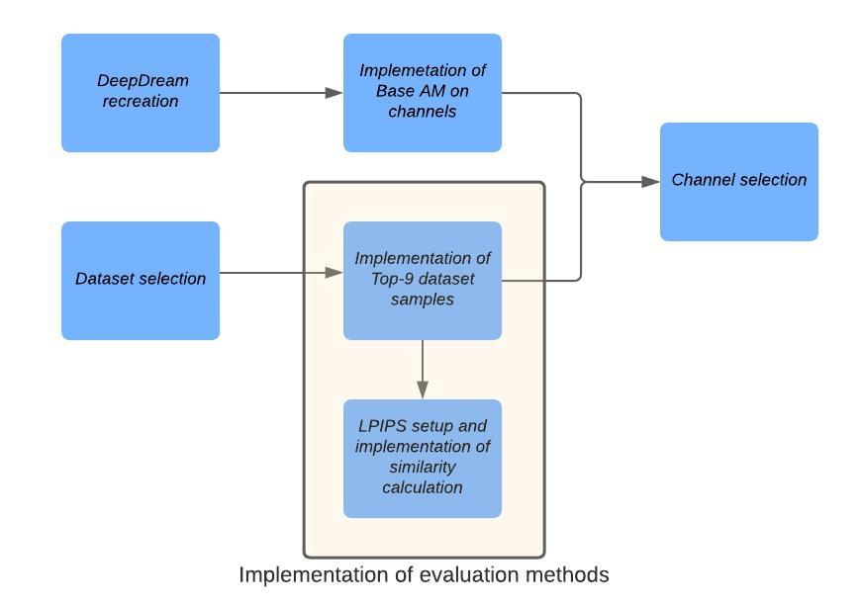
Implementation phase
‘mixed6’

Slide 8
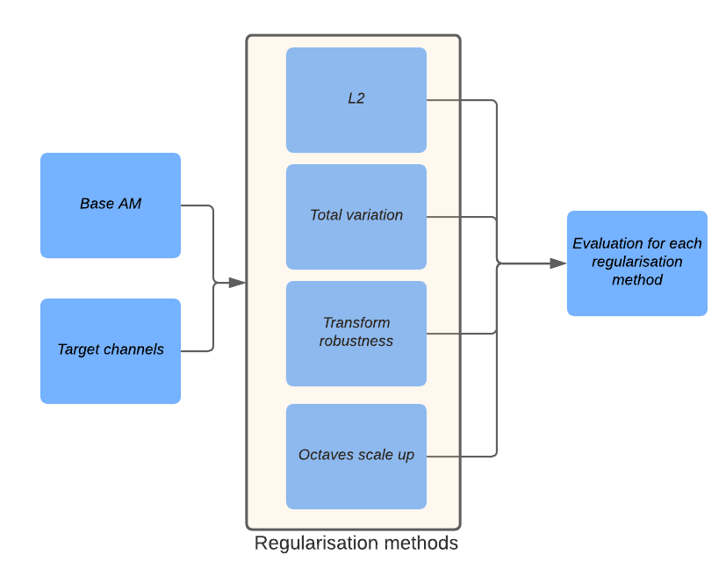
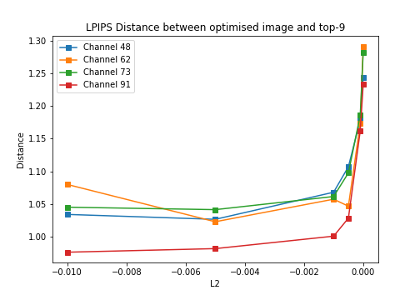
Experiment phase

Slide 9
Results and Conclusions

Slide 10
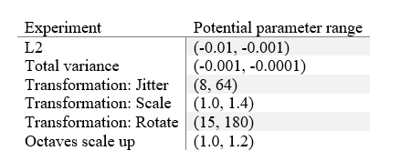
Results
Refined range of potential values for each tested parameter

Slide 11
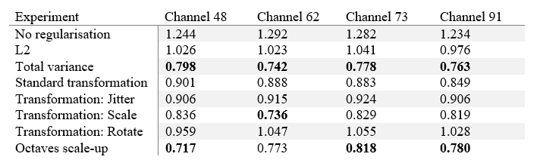
Results
The lowest LPIPS of AM images generated with different regularisations for 4 chosen channels.

Slide 12
Conclusions
All regularisation methods have positive effect on the results to varying degrees
Both of total variance and octaves scale-up improve the AM image by around 39% in average
L2 has the least positive effect on the results (with an average improvement of 19.5%)
19.5%
39.0%
38.8%

Slide 13
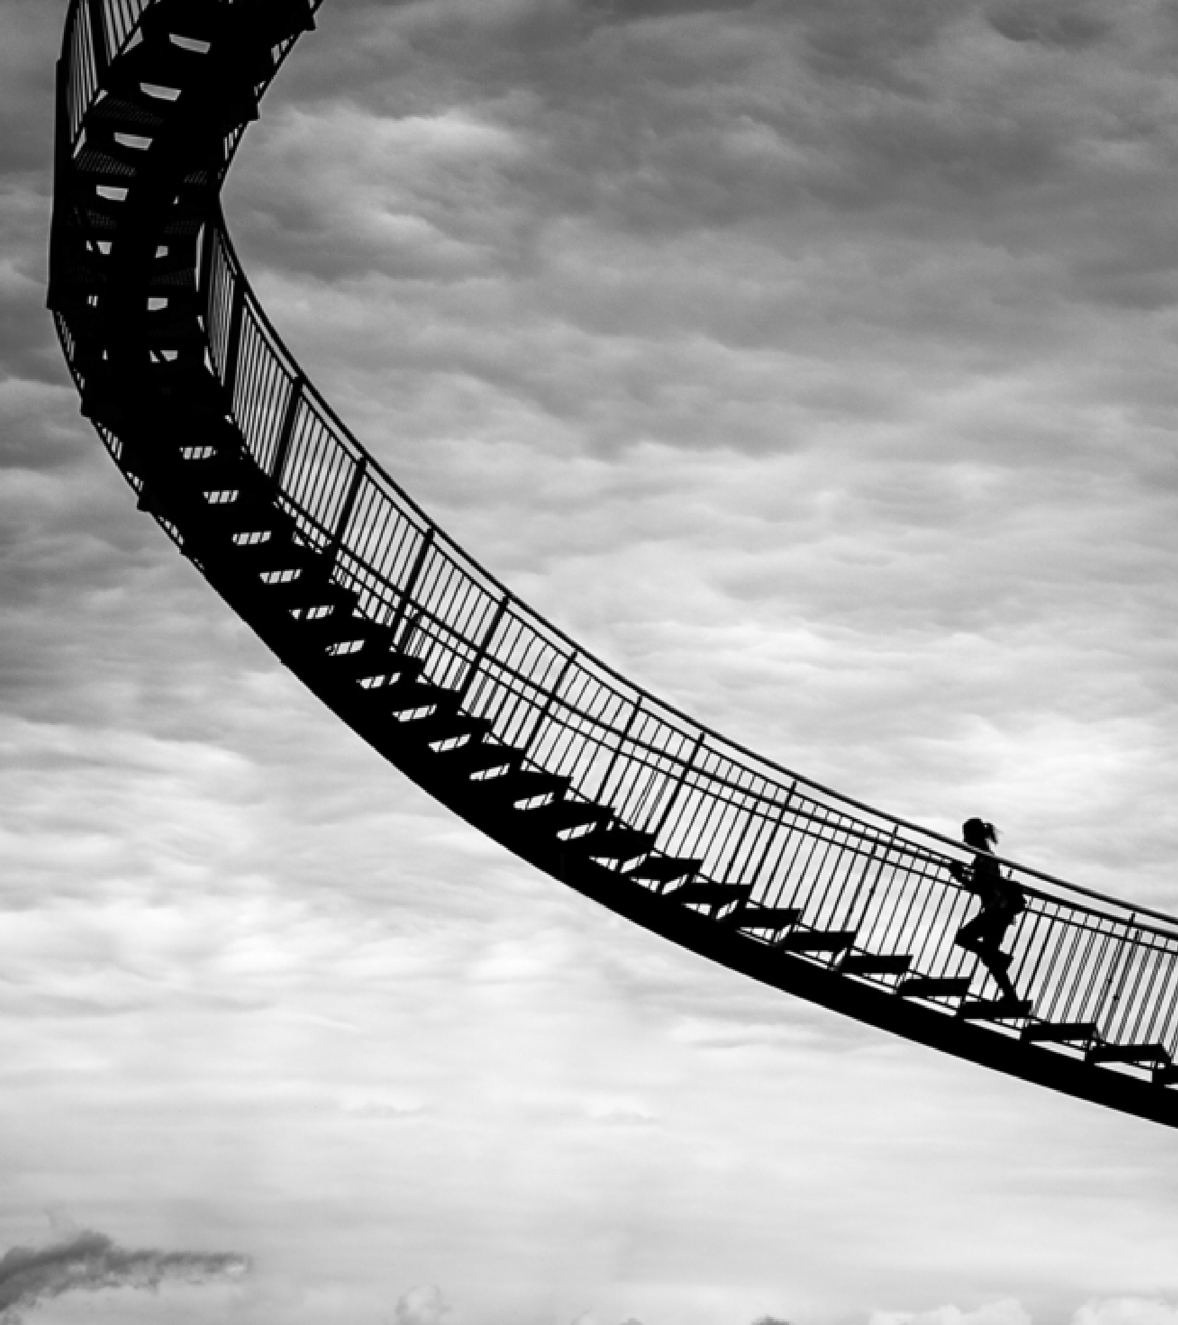
Thank you
Thanks to your patience and support.

Slide 14

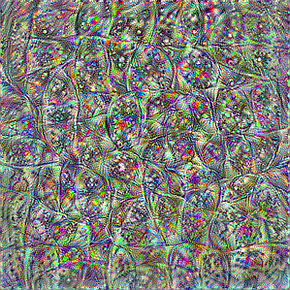
Base AM (channel 0)

Slide 15
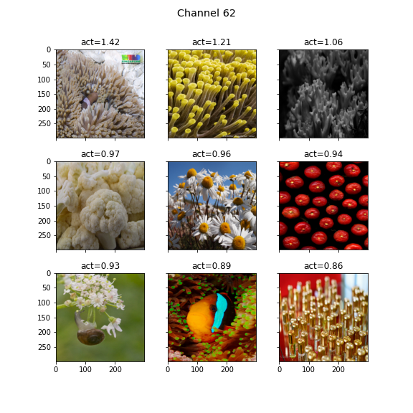
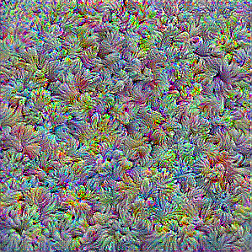
Similarity calculation
LPIPS
Perceptual similarity

Slide 16
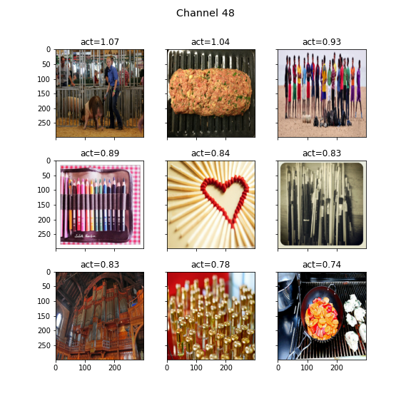
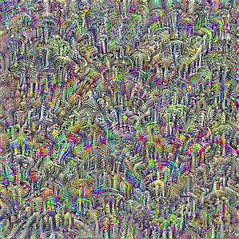
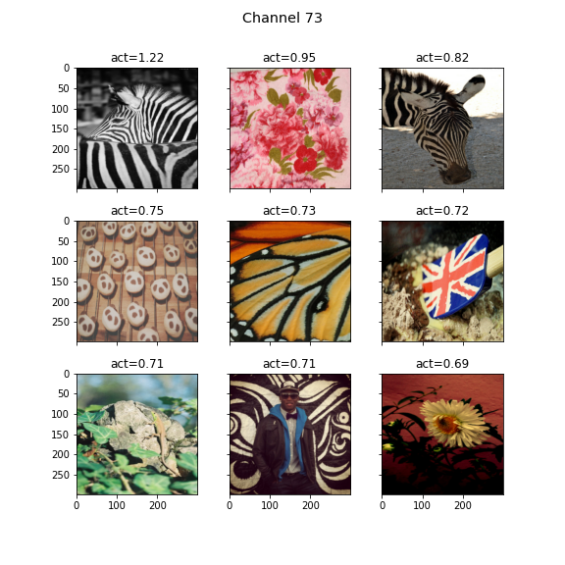
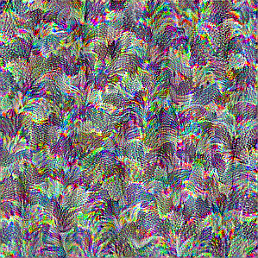
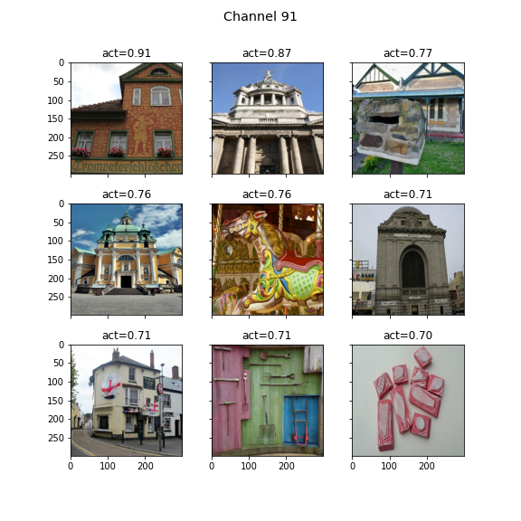
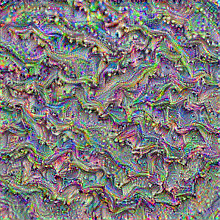
Channel selection (channel 48,62,73,91)
Channel 48
Channel 73
Channel 62
Channel 91

Slide 17
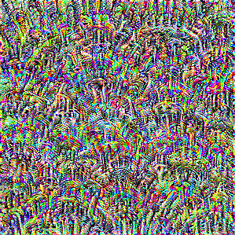

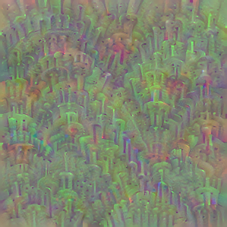
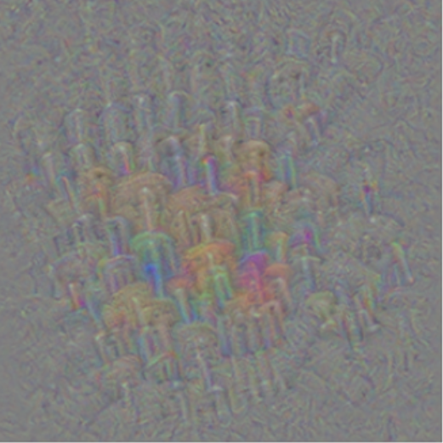
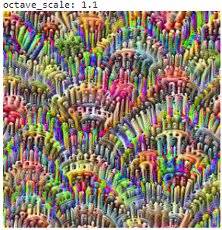
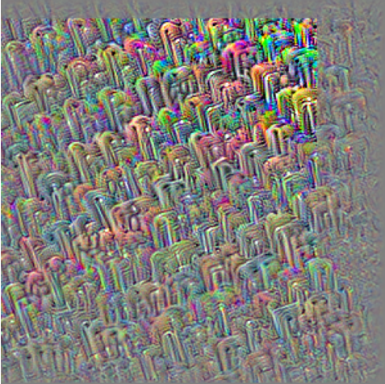
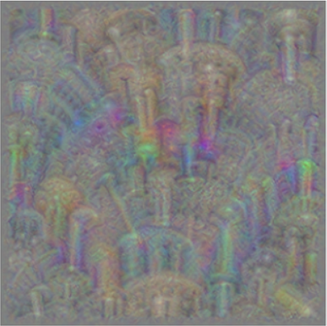
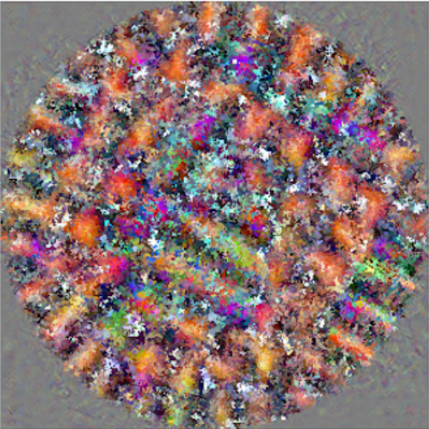
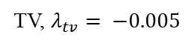
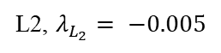
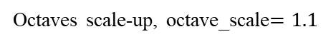
Experiment results (channel 48)
Reference
L2, $λ_{L_{2}}= −0.005$
TV, $λ_{tv}= −0.005$
Standard transformation
Octaves scale-up, octave_scale$=1.1$
Transformation jitter = 16
Transformation scale = 1.2
Transformation rotate = 45

